Slide 1
Influence of synthetic vegetation on suspended sediment capture in laboratory flume experiments
Justin Nghiem
2018-19 Undergraduate Honors Thesis
Department of Geography, UC Berkeley
Advisor: Laurel Larsen

Slide 2
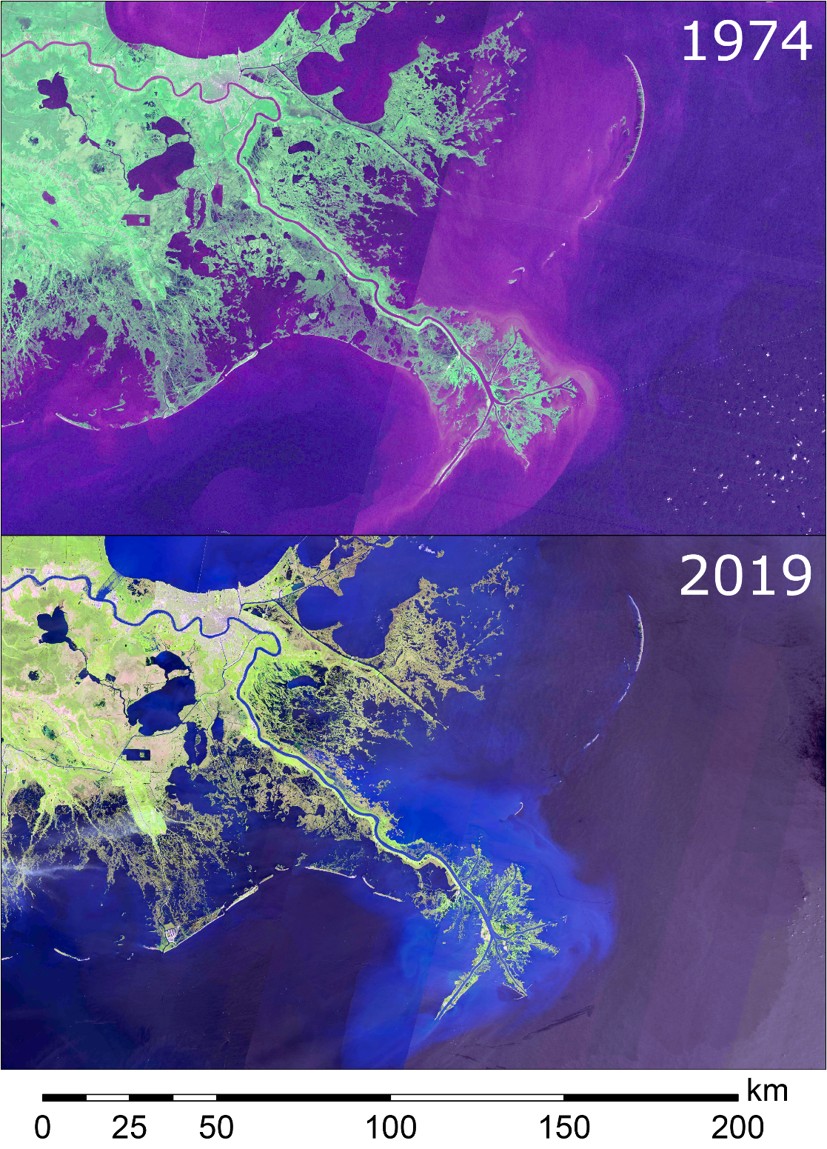
Motivation
Coastal wetlands are facing historically rapid land loss
Mississippi Delta has lost over 5000 km² of wetlands since 1930s
Relative sea level rise accelerates loss

Slide 3
Motivation
Strategy: vegetation enhances retention of transported sediment load
Based on previous studies [Palmer et al., 2004; Wu et al., 2011; Fauria et al., 2015]
Mathematical models to predict particle capture are valuable tools for wetland management
Empirical models of Palmer et al. [2004] and Fauria et al. [2015]

Slide 4
Research Questions
How well do existing models of particle capture by vegetation stems perform?
Are there important but unaccounted parameters?
For specific conditions, what is the influence of vegetation on particle capture in wetlands?
How to respond to these questions?

Slide 5
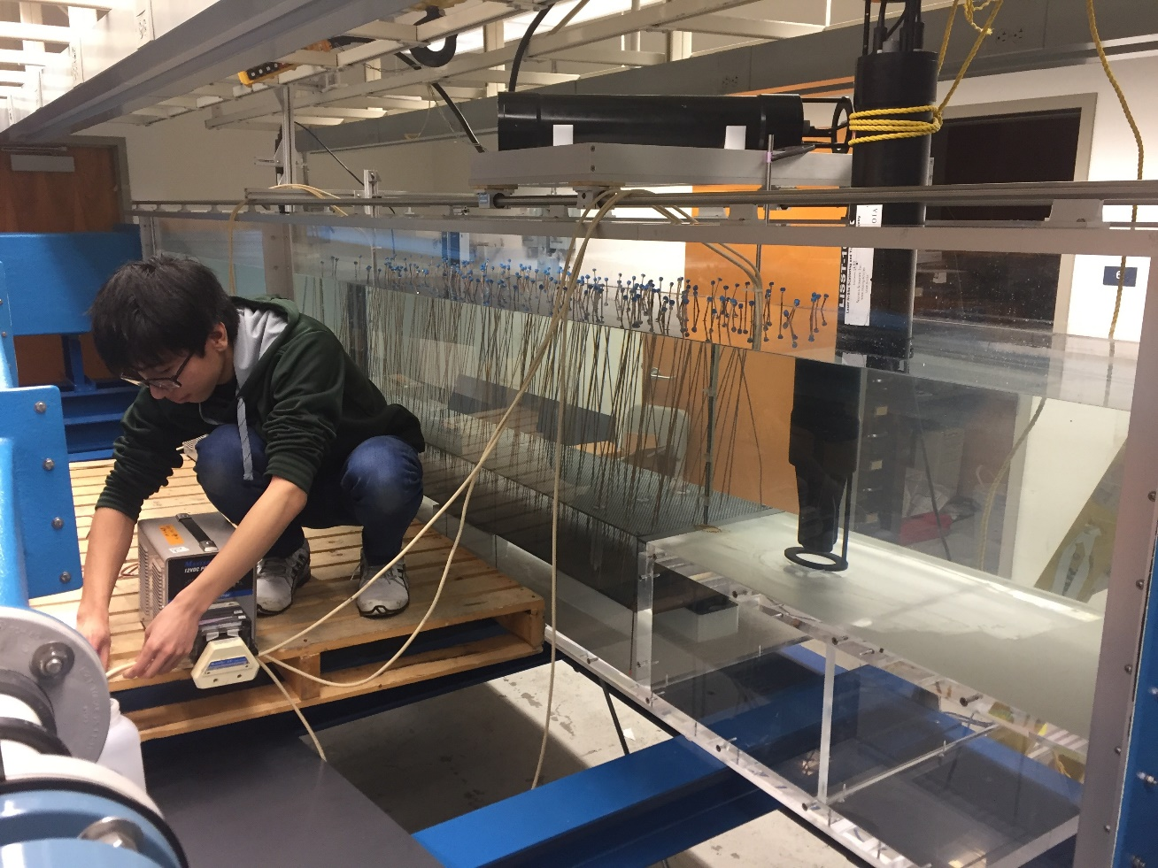
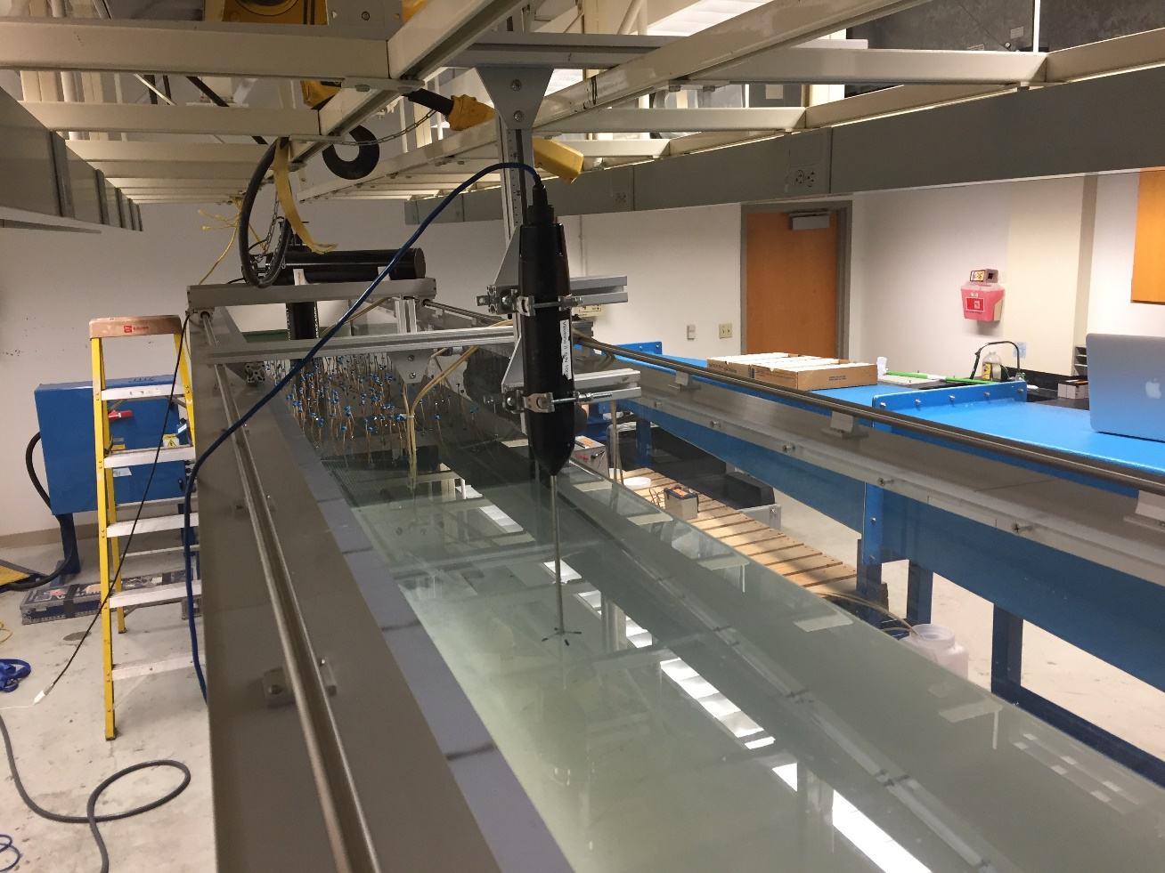
Use a flume

